Slide 1
Piezoelectric Mirror
Linear Polarized Fiber Laser
Excitation Filter Wheel
Laser Beam
Beam Steerer
Xenon Arc
Lamp
Splitter
Fluorescence
Lens
Camera
Automated Interchangeable
Dichroic Mirror
Emission
Filter Wheel
Microscopy Body
Neutral Density
Computer
MetaFluor
Sutter Controller
Image Acquisition
Image Analysis

Slide 2
Table 1. The settings of filters for the Multicolor FRET imaging.
 | Excitation Filter (nm) | Dichroic Mirror (long pass; nm) | Emission Filter (nm)
CFP | 420/20 | 450 | 475/40
YFP (FRET) |  |  | 535/25
mOrange2 | 548/20 | 560 | 572/20
mCherry (FRET) |  |  | 630/20
mCherry | 580/20 | 600 | 630/20
Nikon
GFP/RFP
Camera
Eye

Slide 3
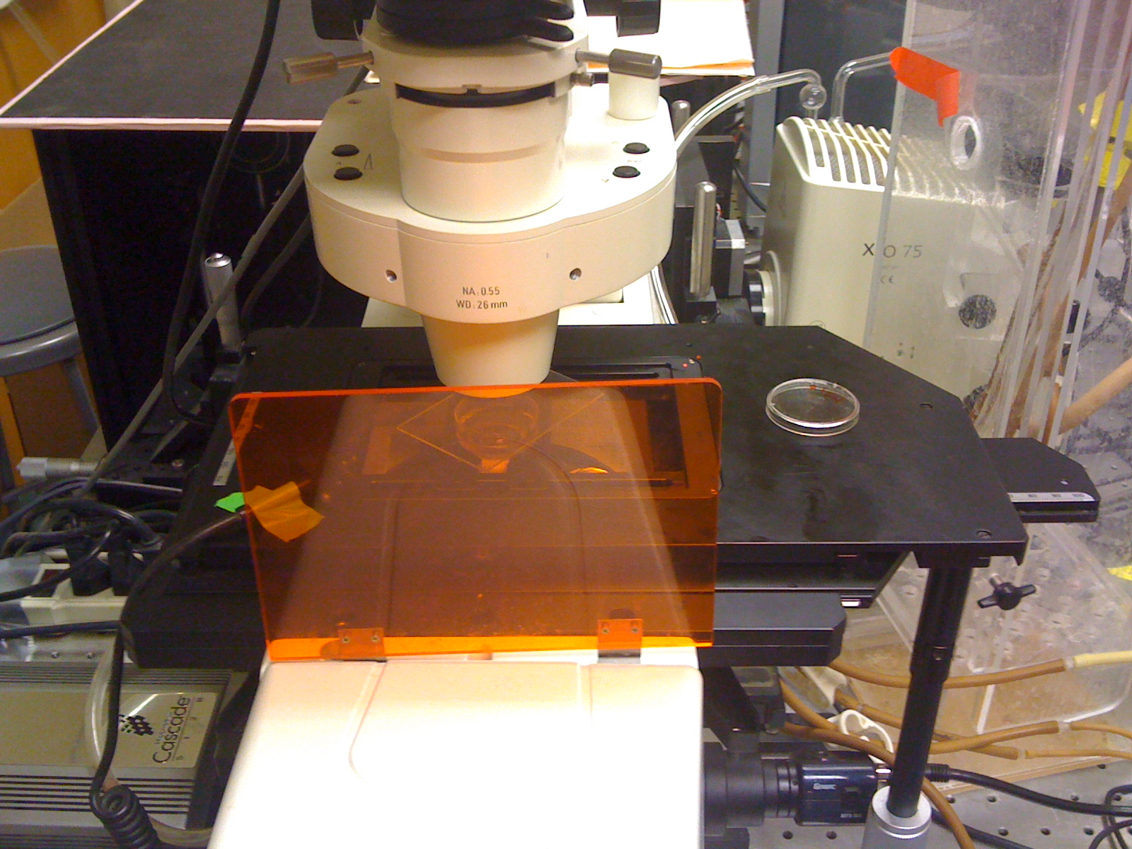

Slide 4
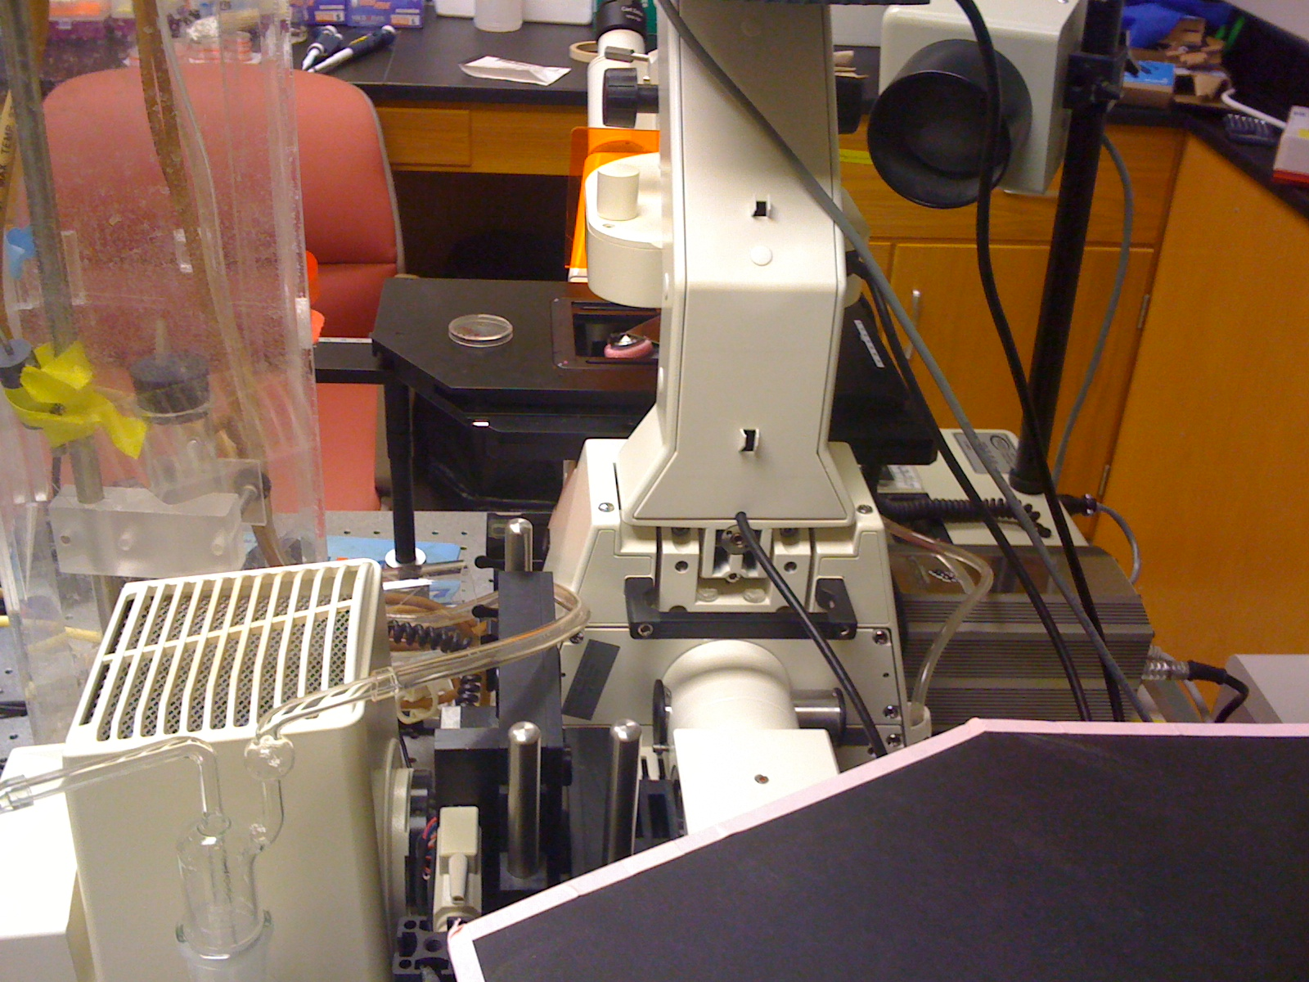

Slide 5
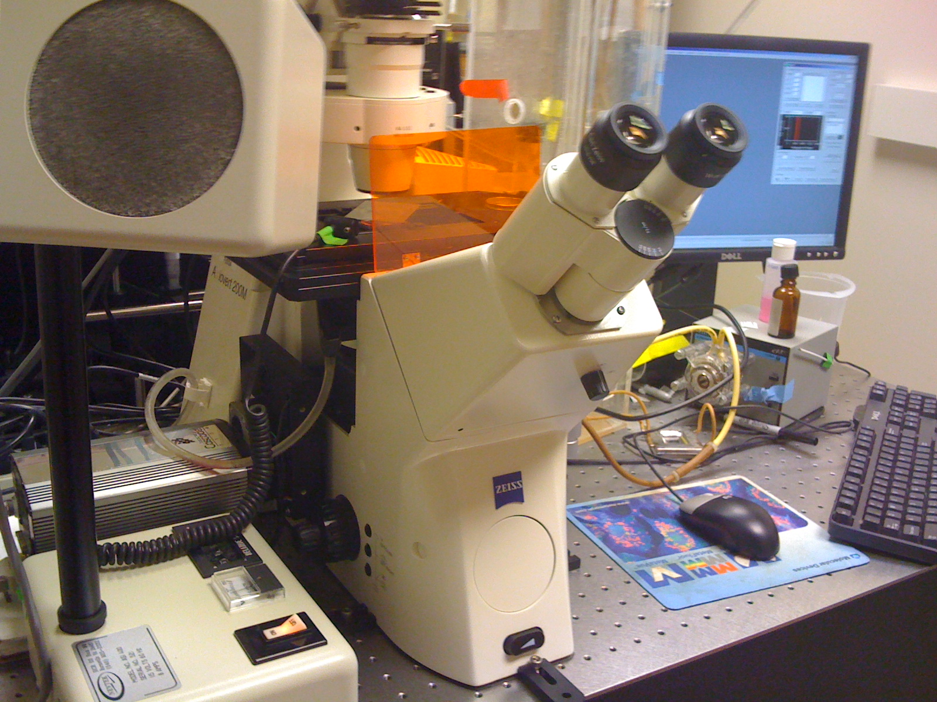

Slide 6
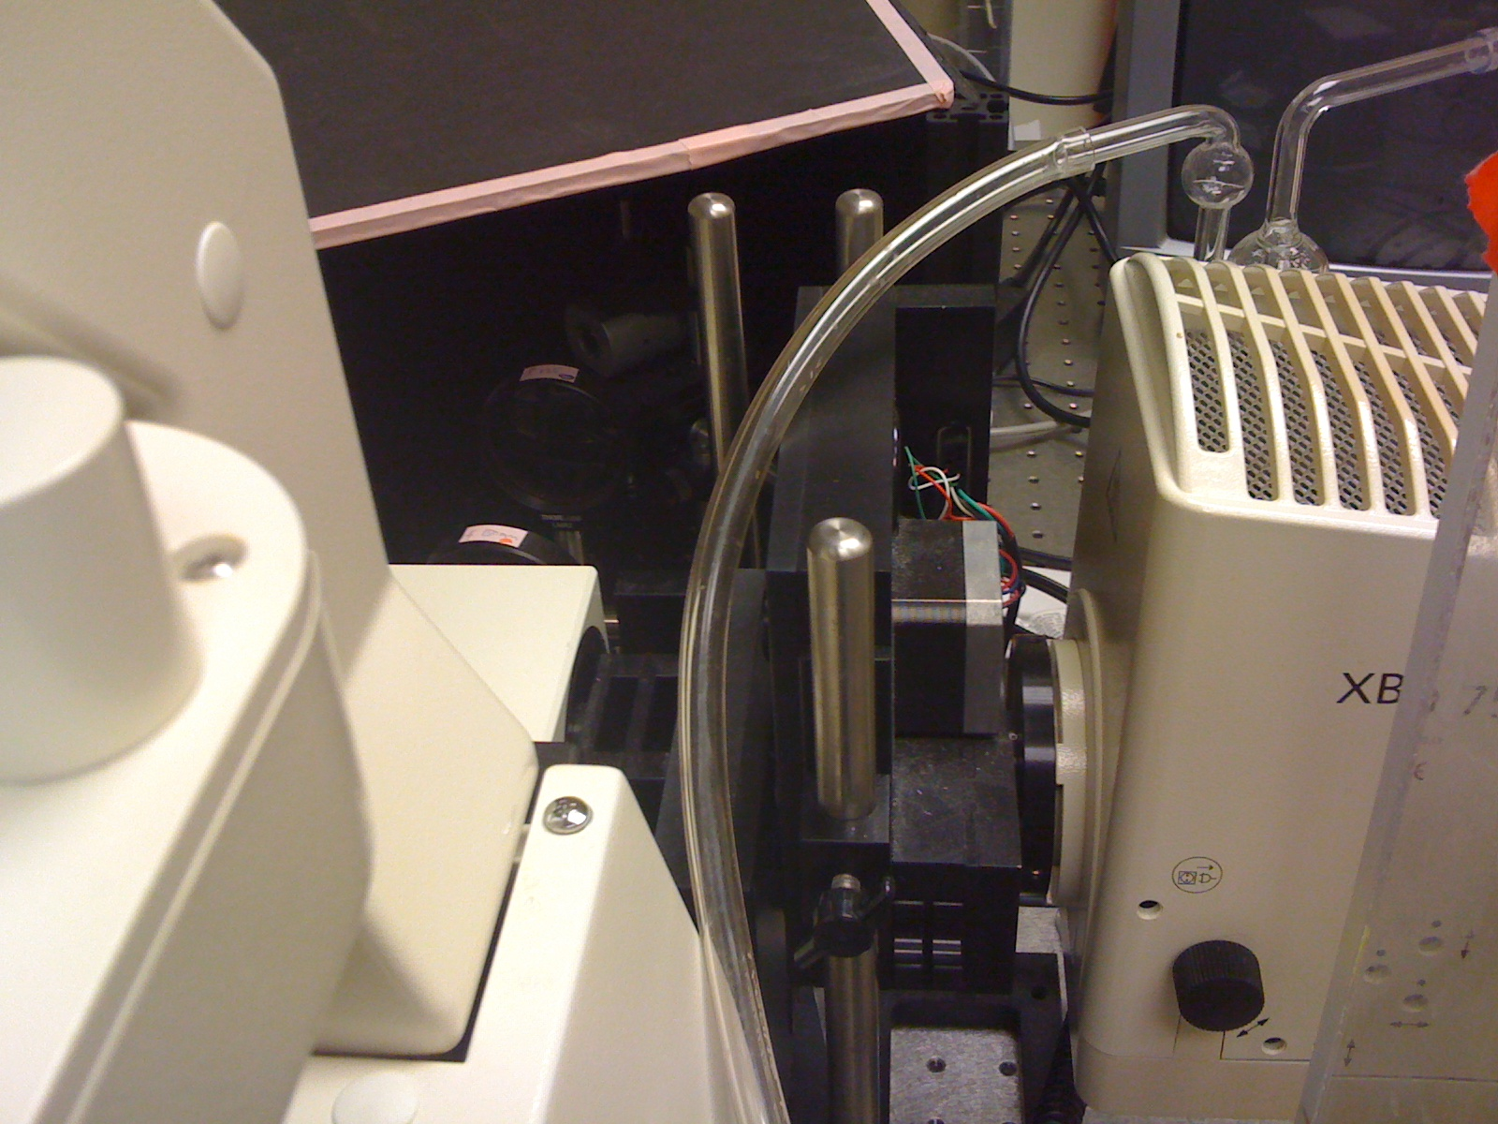

Slide 7
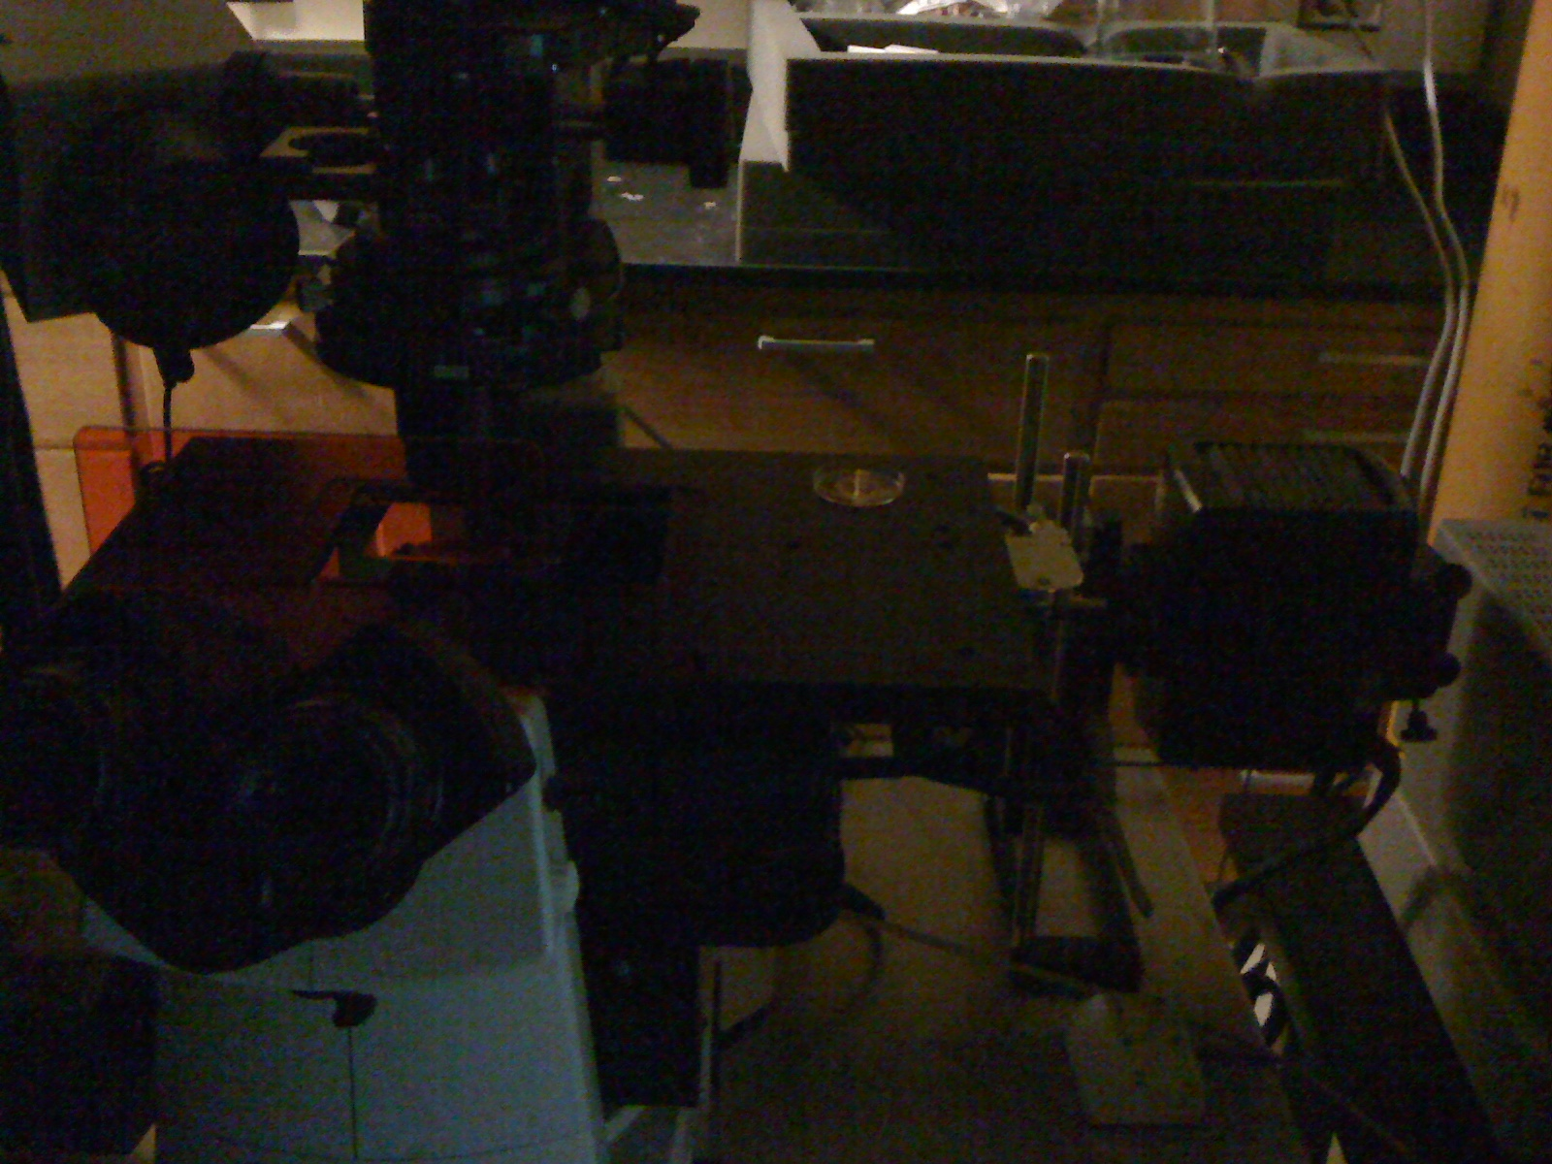

Slide 8
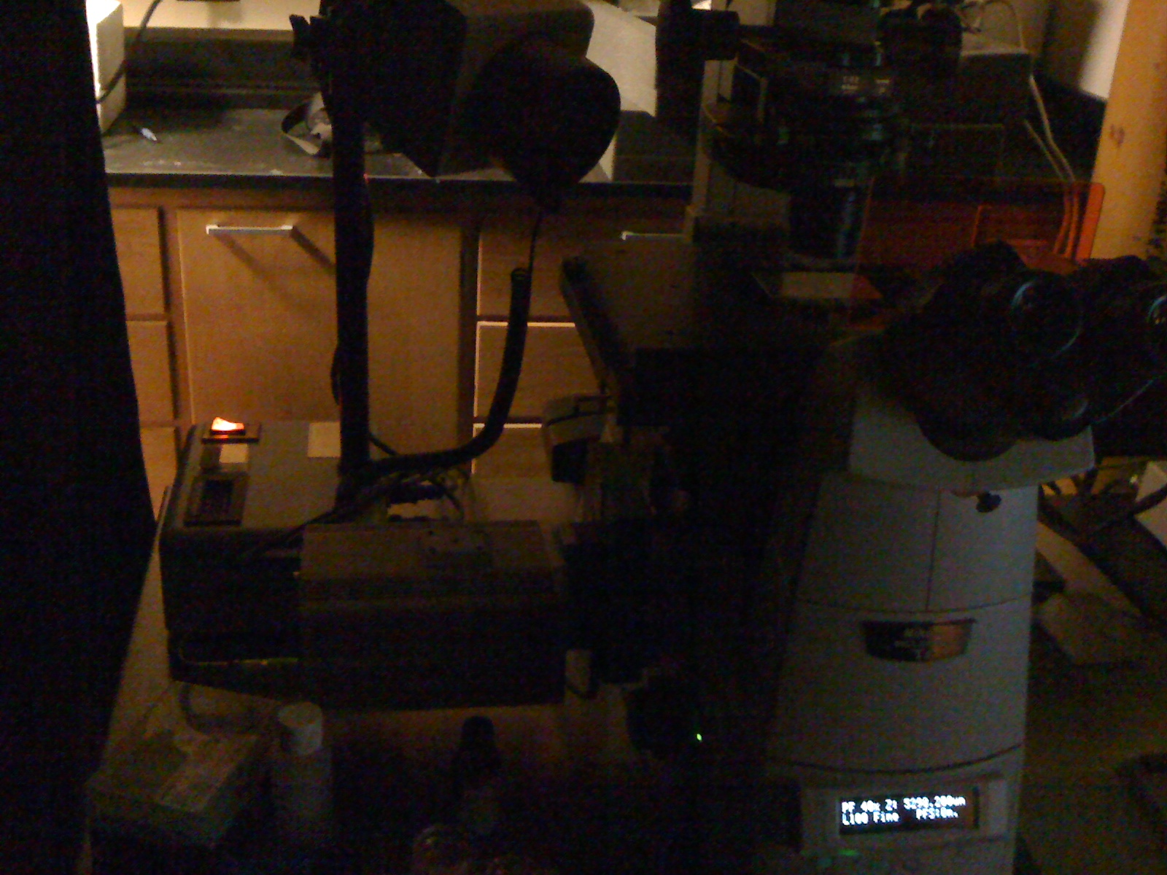

Slide 9
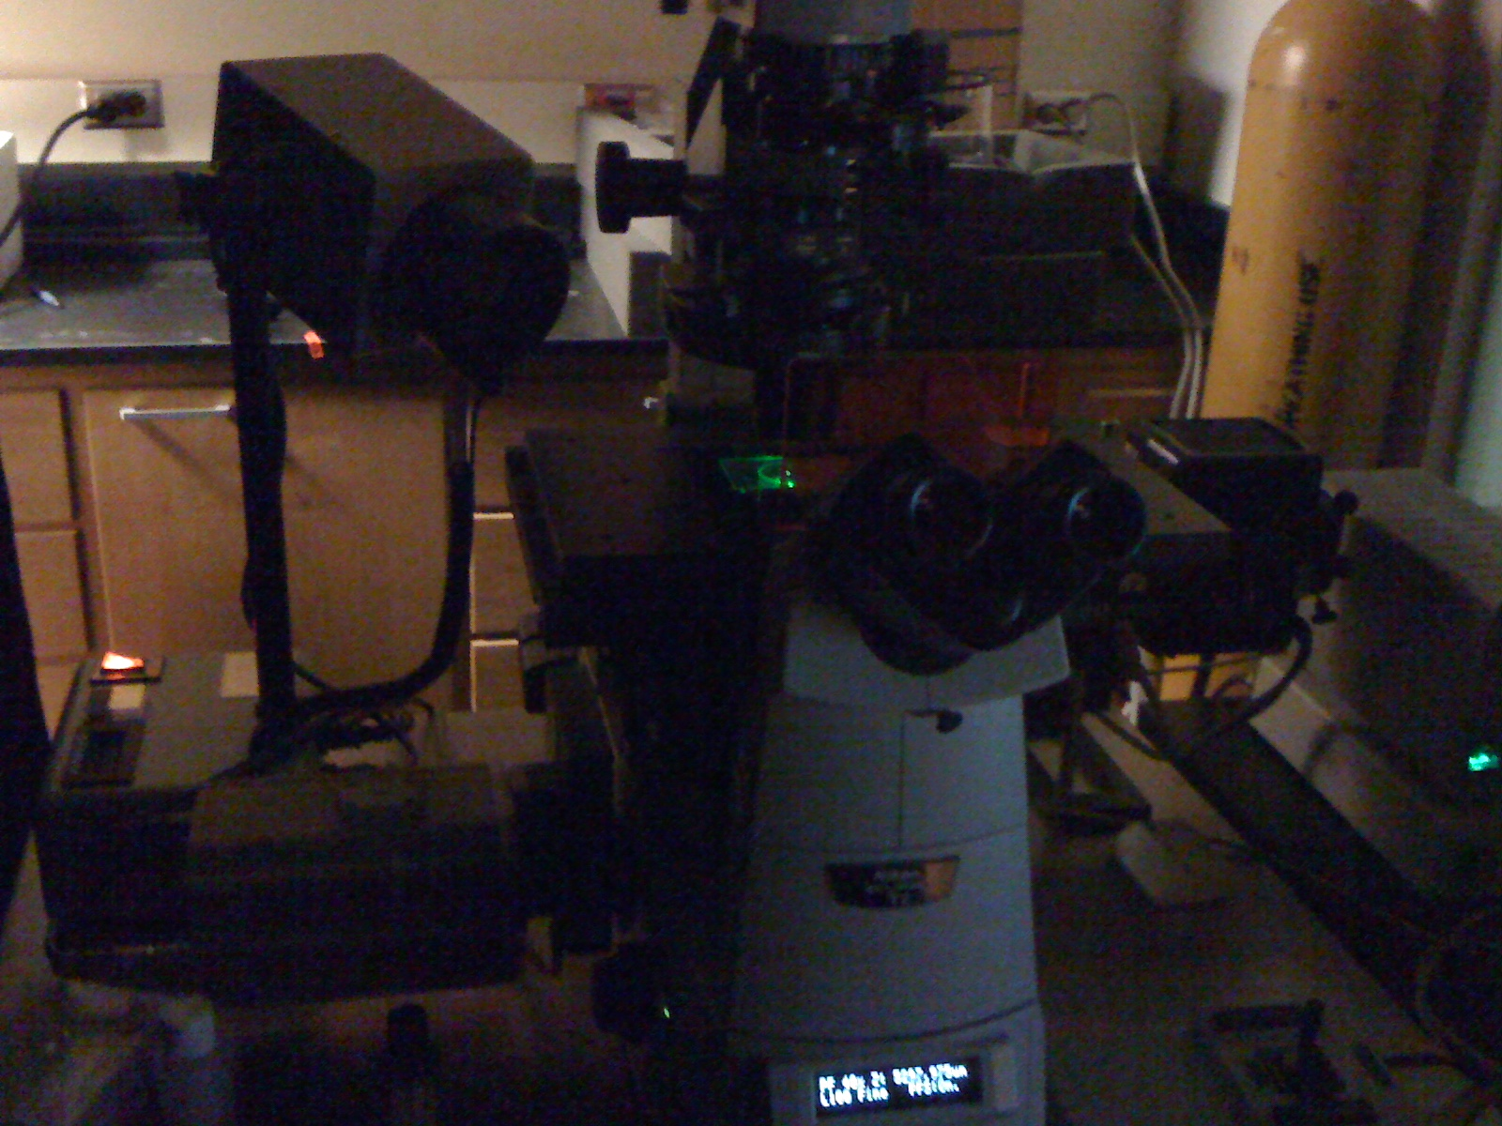

Slide 10
CFP
FRET
A
B
Brightness
Color
Ratio Pseudo Color
IMD Display
A/B
Brightness
Color

Slide 11
IMD Display
Color
1.6
1.6
Brightness
0.95
0.95
Ratio>1.6
1.35
Ratio<0.95
0.95

